Slide 1
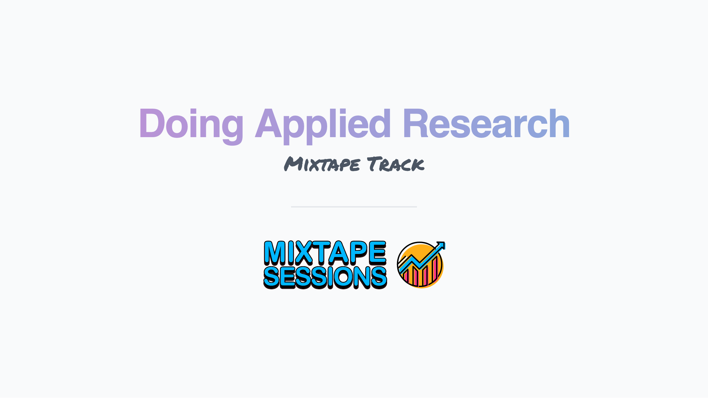
Section 6. Conferences and Networking

Slide 2
Conferences
There are a lot of economics conferences! Which ones should I attend?
I’ll keep this to U.S. conferences…Dan can field questions about European conferences!
As a grad student and junior professor, I went to many conferences
Was able to figure out which ones I liked early in my career
Too much travel, however, comes at a loss of productivity
I think going to 3 or 4 a year is plenty
American Economic Association Annual Meeting
Regional conference (in order of quality: SEAs, WEAs, EEAs/MEAs)
A conference specific to your field. For instance…
Labor: Society of Labor Economics Annual Meeting (SOLEs)
Health: American Society of Health Economists Annual Meeting (ASHEcon)
Environmental/Resources: Association of Environmental and Resource Economists Annual Summer Conference (AERE)
Interdisciplinary conferences that should be on your radar
Population Association of America Annual Meeting (PAAs)
Great place to get research ideas
Association for Education Finance and Policy (AEFP)
Association for Public Policy Analysis and Management Annual Meeting (APPAM)

Slide 3
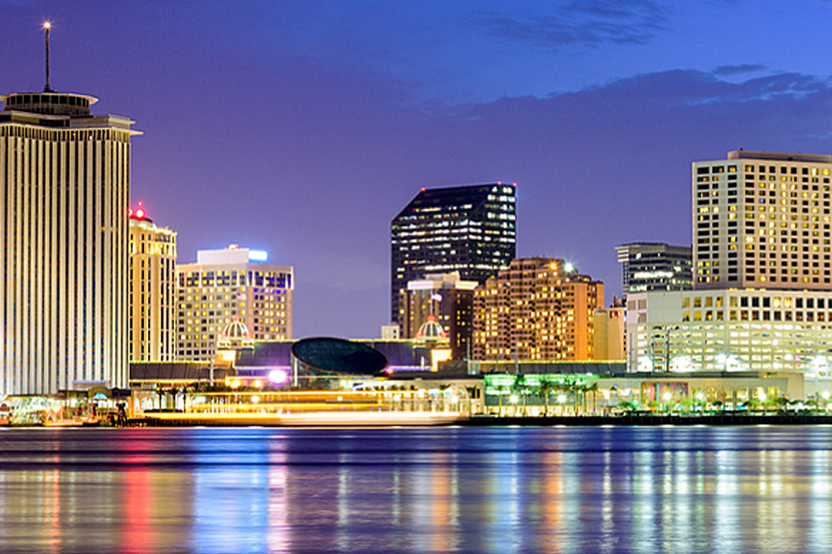

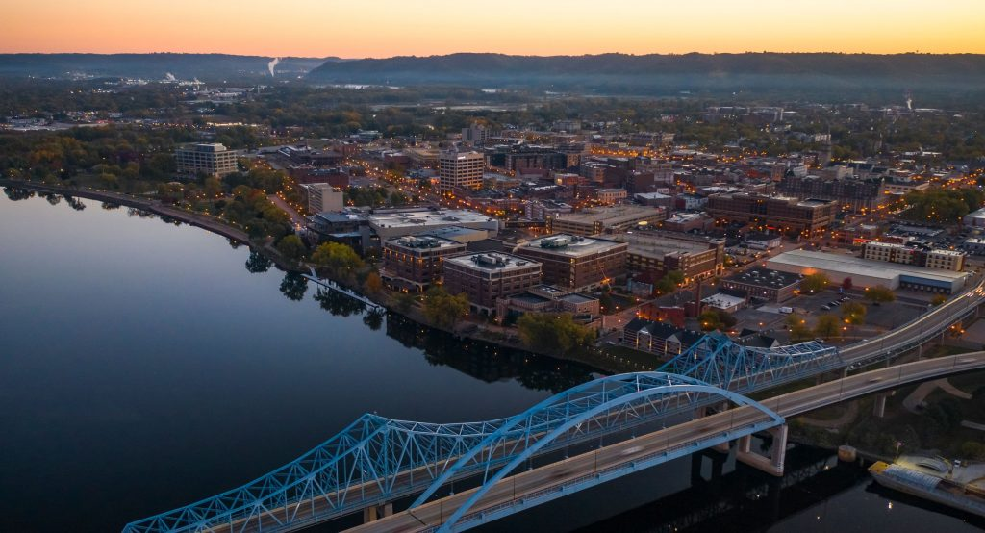
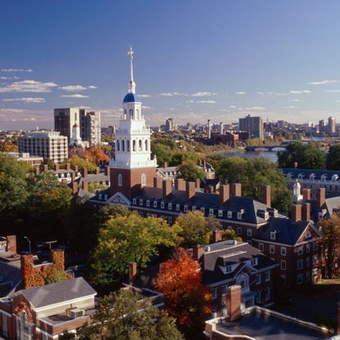
Conferences
New Orleans, LA
I’ve settled on:
American Economic Association Annual Meeting (aka ASSAs)
Tons of high-quality research
Great networking opportunities (everyone is there!)
If you can get a paper accepted, high likelihood some very good economists will see your work
Southern Economic Association Annual Meeting (SEAs)
Lower quality if you attend non-organized sessions
Many high-quality organized sessions
Especially the case for applied micro
Low-pressure conference where one can present research in its earlier stages
Economic History Association Annual Meeting (EHAs)
Field-specific
Smaller and more intimate conference
Generally very high quality
NBER meetings
Many to choose from throughout the year
(fall, spring, and summer meetings)
Summer institute is particularly good
Quality is always very high
Ft. Lauderdale, FL
La Crosse, WI
Cambridge, MA

Slide 4

Organized sessions vs. Single-paper submissions
Starting in your 4th of 5th year of graduate school, try to organize at least one conference session per year.
Great networking opportunity
Potential to meet future coauthors
Shows you are active in your field
Hand-picking people who you want to read your work
It is really fun!
Single-paper submissions can work out
Probably fine at a higher quality conference, such as the ASSAs.
But, if you submit to, say, the SEAs as a single-paper, there is some chance the room will look like this…

Slide 5
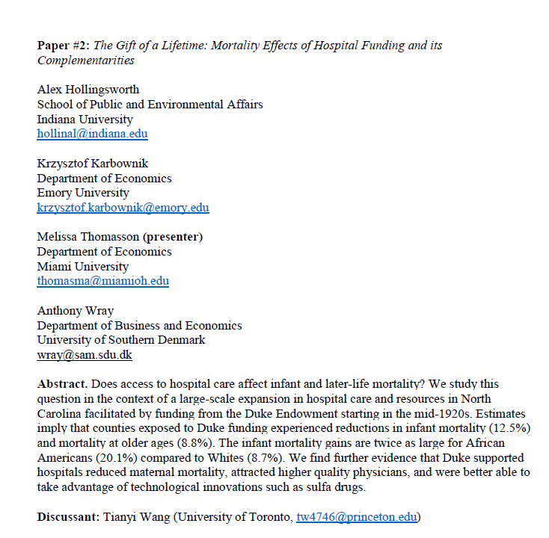
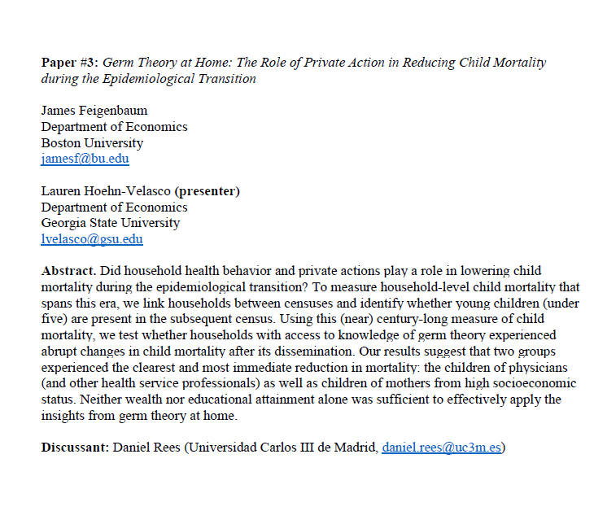
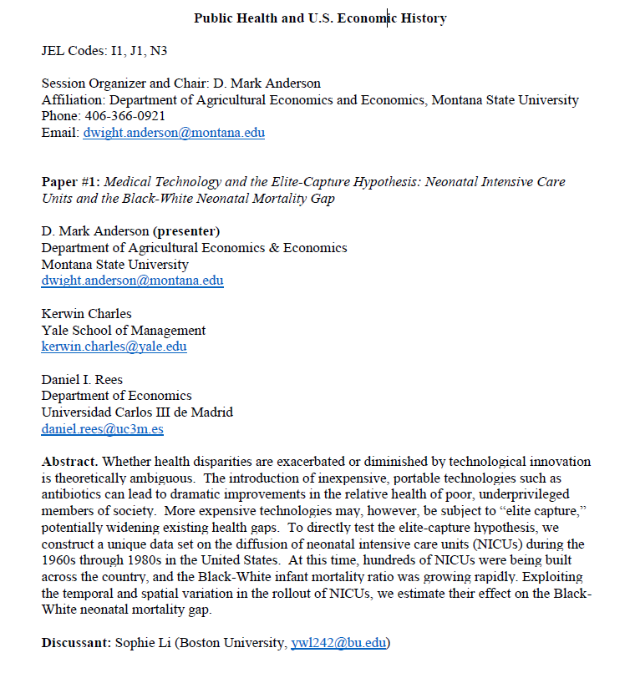
Template for a conference session submission
Now go and do this!!!

Slide 6
Conferences cost money
As a junior professor, hopefully this isn’t an issue.
As a graduate student, this can be a problem.
Departments and advisors may be able to fund some of your travel, but don’t count on this.
Student travel grants at your university, however, likely exist
Application process is usually not too onerous
Can probably fund one or two trips a year this way
Look for funding from the various colleges at your university, but also from research centers
External travel grants also exist, but you have to search for them.
Some associations will fund grad student travel (e.g., Economic History Association, Agricultural and Applied Economics Association)
Centers at outside universities (e.g., Institute for Humane Studies, https://www.theihs.org/funding-opportunities/)
The AEA maintains a list of various funding opportunities for graduate students: https://www.aeaweb.org/resources/students/grad-prep/funding.

Slide 7
Virtual Conferences and Seminars
Since COVID, a number of high-quality virtual-only seminar series have been established.
Examples include: Virtual Crime Economics (ViCE) seminar series (http://jenniferdoleac.com/vice-seminar/); Virtual Economic History seminar series (https://warwick.ac.uk/fac/soc/economics/staff/crei/vhs/); Applied Machine Learning, Economics, and Data Science (AMLEDS) seminar series (https://sites.google.com/view/amleds/home)
AEA maintains a long list of online seminars: https://www.aeaweb.org/resources/online-seminars
Great way to keep up with research in your field
But, keep in mind the productivity trade off associated with sitting in seminars all day long!
Harder to connect with other economists virtually. Don’t consider virtual conferences and seminars as a substitute for in-person meetings
I’ve met future co-authors at in-person conferences
I’ve never met a future co-author at a virtual conference

Slide 8
Networking
Identifying potential co-authors (or just future friends in your field)
Conferences!
Avoid the “helicopter” approach
Don’t go into “hover mode” and look like a stalker!
Walk-up, introduce yourself, and be ready with a research-specific conversation starter.
Be approachable, circulate, look open and engaged
Don’t be a “fan-girl” or “fan-guy”
It is great to meet the big-names, VIPs, guest speakers, etc., but don’t spend your entire time trying to connect with them.
Spend your time listening, learning and connecting with others who have similar interests.
Dinners and “meet-ups” are a great way to network
Your department’s seminar series
Don’t be shy…get on the speaker’s schedule!
Do not forgo these opportunities, especially as a graduate student.
These meetings probably won’t turn into co-authorships, but they can be extremely valuable
Do not be afraid to “cold-call” someone via email
The worst thing they can do is ignore your email…that’s a pretty low-cost outcome
Send a draft of one of your working papers and politely ask for feedback.
This is how I met Dan!

Slide 9
Networking: FAQs
Do I need to try and write with as many people in my field as possible?
I thought I needed to cast a broad co-author net early in my career
This might be the only way you can find a good “match”
But, once you’ve identified a few people who you work well with, do not feel like you need to write with everyone else
Working with people who you do not mesh well with (for whatever reason) can be a disaster
If you have a couple of great co-authors, just write lots of papers with them.
Dan and I have published 21 papers together!
Should I cold-call someone and ask for their data?
If the data are publicly available, I (and others) view this as an annoying request.
If the data are not publicly available, and the author is free to share them, then the request is acceptable.
But, don’t come across as pushy or entitled because we live in a world where data sharing is encouraged
Be EXTREMELY appreciative
Remember, it could have taken the author an exceedingly long time to collect the data.

Slide 10
Networking: FAQs
As a young professor, should I get involved with my department’s seminar series?
YES!
Many departments try to protect their juniors from service-related duties.
It takes effort to run a seminar series, but as a junior professor this experience can be extremely valuable
Invite people in your area
Invite editors from journals
Even as a graduate student, if your department will let you help in organizing the seminar series, go for it!
If you are in department with a sparse seminar budget, try to find some grant $ to help fund it.
If you are in a department with 5 seminars/week (or more!), get involved with the one specific to your field. Here is where you do not want to spread yourself too thin.

Slide 11
Q&A (≈ 10 minutes) + Break (≈ 5 minutes)

